Slide 1

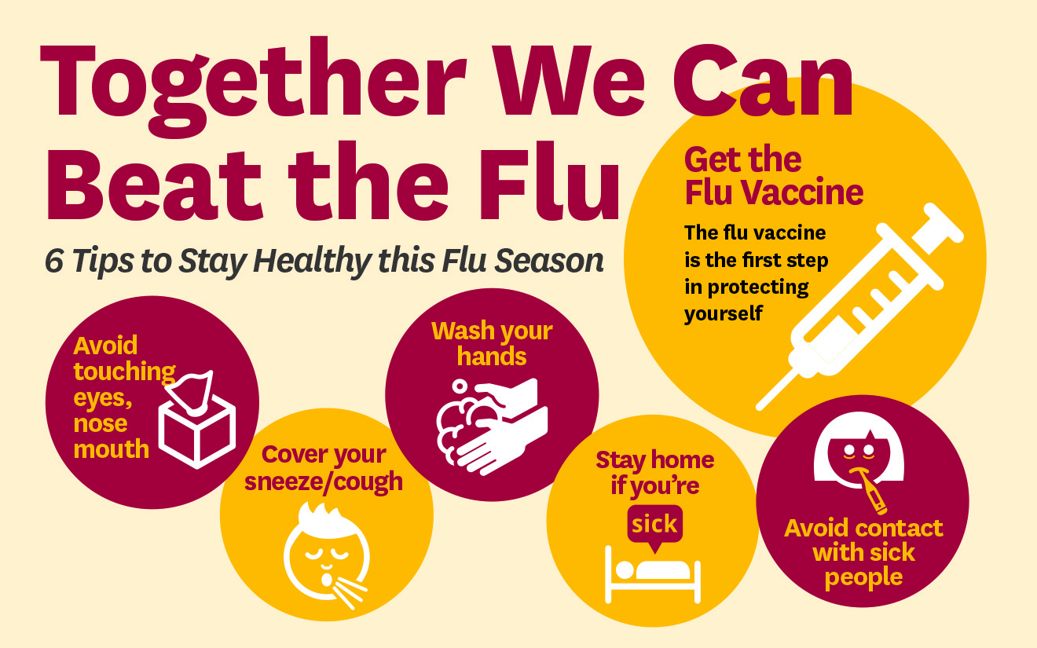

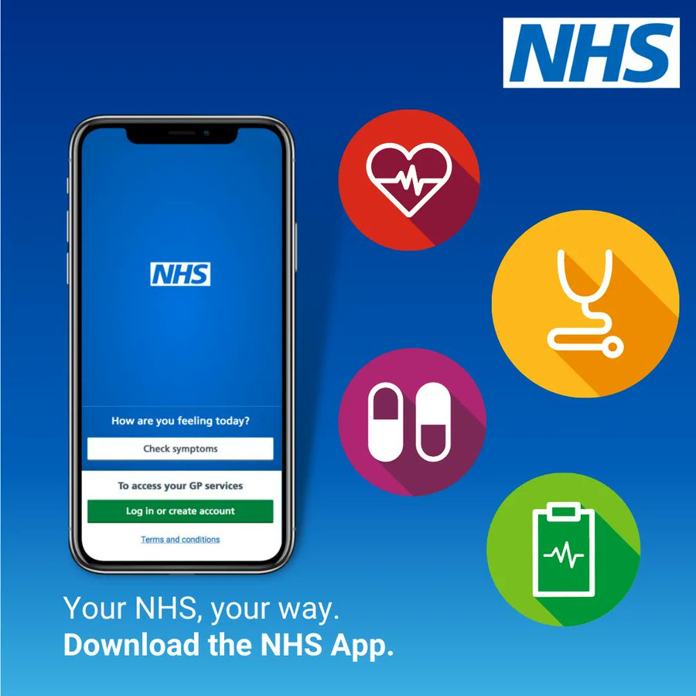


Grenoside Surgery
Practice Newsletter
Welcome to the latest issue of our Practice Newsletter
Useful Numbers
Northern General Hospital (0114) 243 4343
Royal Hallamshire Hospital (0114) 271 1900
Sheffield Children’s Hospital (0114) 271 7000
Weston Park Hospital (0114) 226 5000
Charles Clifford Dental Hosp (0114) 271 7800
Pharmacies
Well Pharmacy (Grenoside) (0114) 245 0021
Allied Pharmacy (Margetson) (0114) 232 1741
Well Pharmacy (Southey) (0114) 232 5462
Asda Pharmacy (Chaucer) (0114) 294 4250
Parson Cross Pharmacy (0114) 240 0390
Patient Participation Group
Minutes have been uploaded on Grenoside’s website under Patient Participation Group.
Dates for Covid and Flu Clinics 2025:
Monday 22nd Sept
2–3-year-olds and pregnant patients Flu Grenoside
Wednesday 1st Oct – All day & Late night Flu Grenoside
Thursday 2nd Oct
Flu Grenoside & Wadsley Bridge
Friday 3rd Oct Flu Grenoside
Saturday 4th Oct 9am-2pm Covid & Flu Grenoside & Wadsley Bridge
Wednesday 8th Oct – Late night clinic
Covid & Flu Grenoside & Wadsley Bridge
Housebound patients will be communicated to in advance of visiting dates.
Please support the practice by having your vaccination for flu and Covid here at Grenoside and Wadsley Bridge Surgery. Practices are funded to provide these vaccinations and by coming to the surgery we are able to recycle this income into care for our patients throughout the year.
The practice will be closed for staff training one afternoon a month from 1.00pm
The Next PLI is:
17.09.2025
Should you need a doctor during this time, please telephone the surgery number and your call will be dealt with by the GP collaborative
If you are unable to attend always cancel your appointment
To cancel or rearrange
call us on 0114 240 3159
24 hours a day
Select option 1 to leave a message
Text 07758 721550
Visit the practice in person to rearrange
Updates
Total Triage is going well and having a very positive response from patient feedback. If anyone has any questions or concerns please telephone Beth to discuss.
What would you like to
see in this newsletter?
Do you have any ideas?
If so, please speak to Kara Eaves or leave a suggestion at reception.

Slide 2

Get boosted in time for winter
We are encouraging everyone eligible to take up their offer of a free flu vaccine and a COVID-19 booster.
Unpaid carers, people aged over 65 or who have a learning disability are among those who qualify.
Flu and COVID-19 can both be life-threatening and spread more easily in winter.
The vaccines provide an added layer of protection against the two illnesses, both of which are expected to become more prevalent as the temperature drops and people spend more time indoors.
If you support someone with a learning disability you can help to make sure they have good access to healthcare by supporting them to:
Be on the GP learning disability register ask their GP practice for additional information adding to their summary care record, have the right health checks, screening and immunisations and to carry out the actions in their health action plan.
Mencap has produced this easy reading guide about the COVID-19 booster for people with a learning disability Winter vaccinations | Mencap

Slide 3
